Slide 1
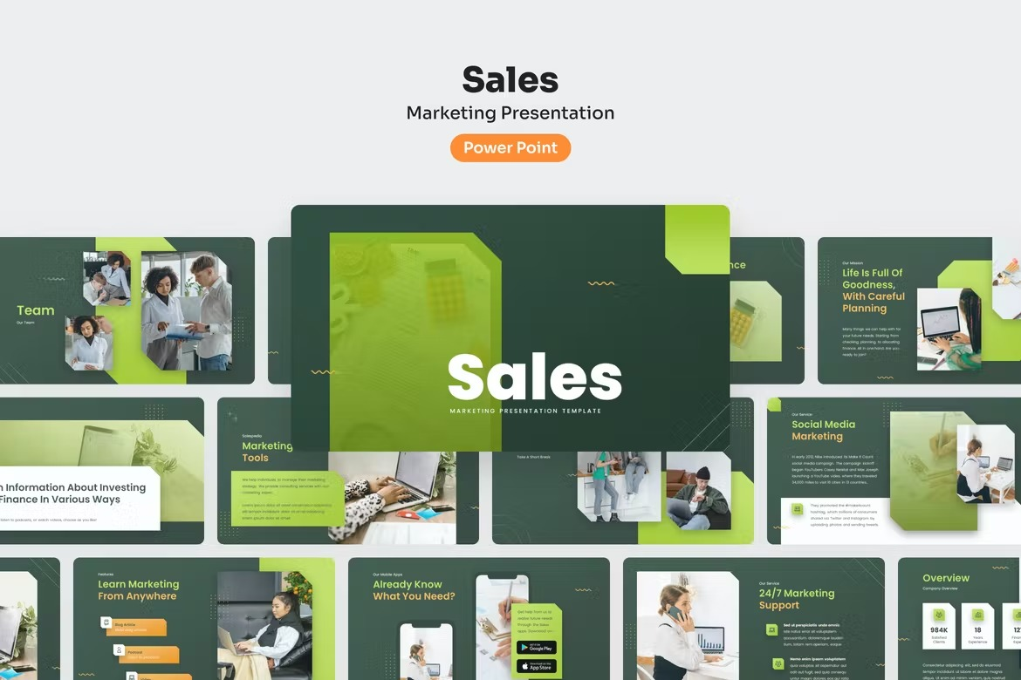

Slide 2
Table of contents
About Project
What Age Group Buys from us the most?
What Payment Method is used most by Age_Groups – Card
What Browsers Our Customers use most – Chrome
Best Month For Sale-December
Total Revenue and no. of purchases by Gender
Avg Time spent by Gender
Skills

Slide 3
Online Sales- Only Pandas Project
So , we will be going through some of the analysis in this online shop customers sales. As you must have seen the value in columns , most of them are in numbers. So what we will do is to convert those numerical columns to Categorical columns for better understanding.

Slide 4
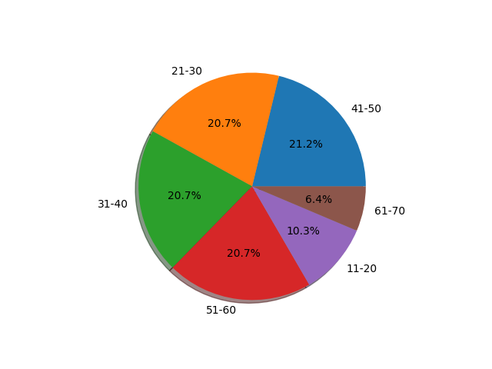
What Age Group Buys from us the most ?

Slide 5
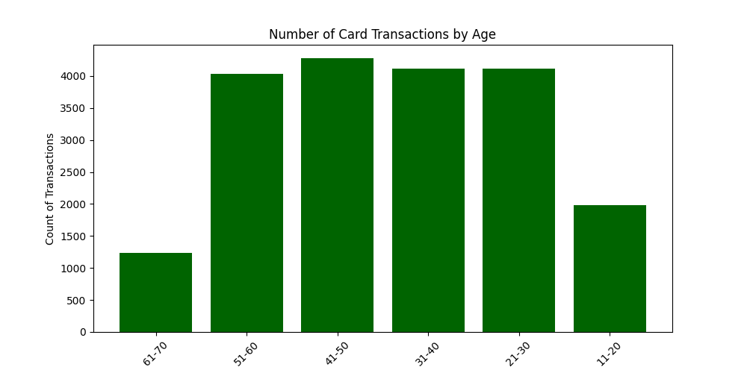
What Payment Method is used most by Age_Groups - Card

Slide 6
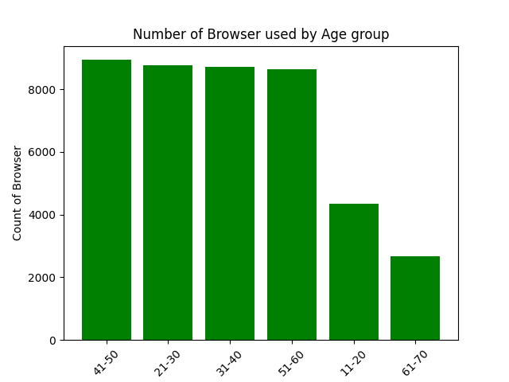
What Browsers Our Customers use most - Chrome

Slide 7
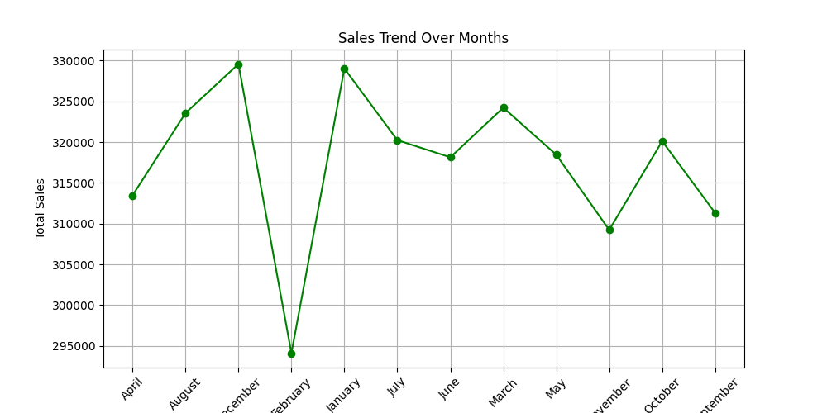
Best Month For Sale-December

Slide 8
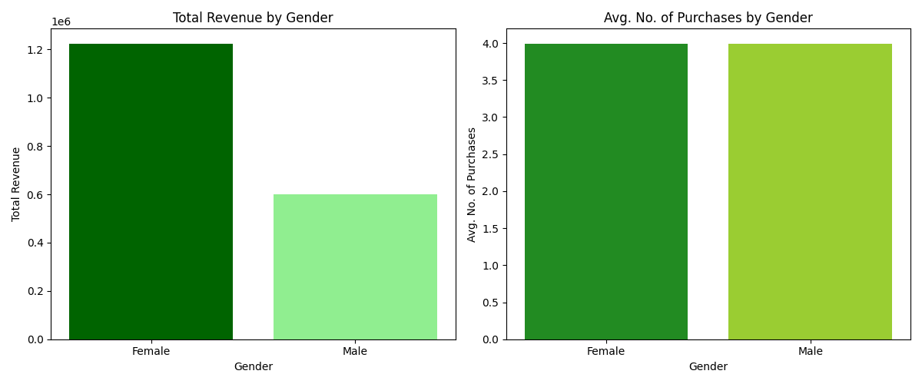
Total Revenue and no. of purchases by Gender

Slide 9
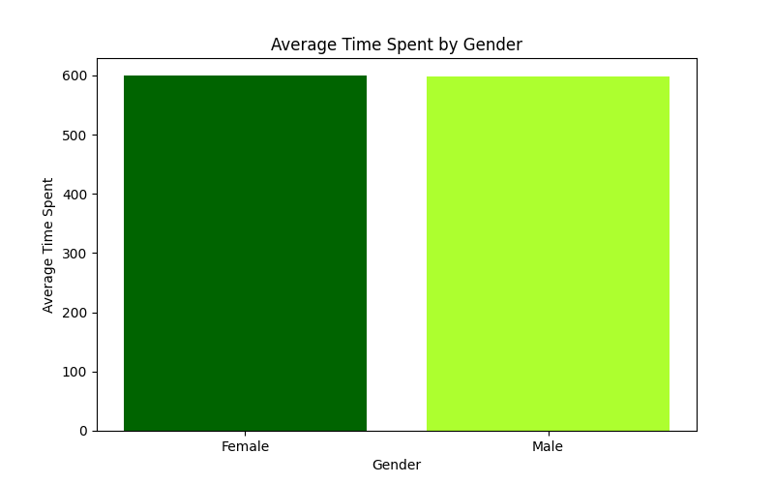
Avg Time spent by Gender

Slide 10
Skills
Skills: Pandas (Filtering, Groupby, Function In Pandas, Aggregate Functions)

Slide 11


